Slide 1

UNIT
DAY 17
02
HELLO, WHO ARE YOU?
BUILT TO ORDER
AGENDA
REMINDERS
Phones into The Holding Cell
Laptop charged and plugged in, today involves a big download
ICA 2-1 downloaded from ManageBac before you start
Unit 2 Overview
Installing PyCharm
Getting Started
Print
Variables
Input
Data Types
Type Casting
Your First Tool
Before You Leave
RECOMMENDED LISTENING:
FLOWER MAN - DELTARUNE

Slide 2

THE WARM UP QUESTION
Back on Day 5 we hand-traced the Little Man Computer
It fetched one instruction, did it, then went and got the next one
What happened when we handed it an instruction it did not understand?
Notes:
They have done this before, on paper, in September. Say so.

Slide 3
THE WARM UP ANSWER
Answer: it stopped. It didn’t skip the line and it didn’t guess what we meant
We followed those eleven instructions exactly, because we were pretending to be a chip
Python works the same way, with a few hundred more words to it
Everything that breaks today is one of two things
  We said it wrong
  Or we never said it at all

Slide 4

UNIT 2 OVERVIEW
New unit, new client
  In Unit 1, you built a game for a group
  But, in Unit 2, you’ll create a specific project for an individual
Notes:
Partners get named Day 18. Not today.

Slide 5
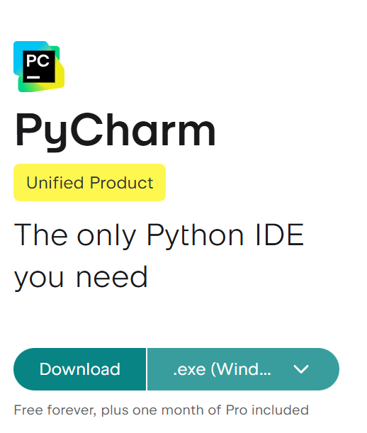
INSTALLING PYCHARM
Go to jetbrains.com/pycharm/download
There is only one PyCharm now
  The free Community Edition was retired in 2025, so don’t go hunting for it
Grab the installer that matches your machine
  Windows: the .exe, likely x86/x64 unless you’re on an ARM chip
  Mac: the .dmg, check whether you’re Apple Silicon or Intel
Start this download NOW, it might take a minute
[PICTURE] the download page with the right button circled, both platforms

Slide 6
INSTALLING PYCHARM
Windows: run the .exe and take the defaults, but tick two boxes
  Create Desktop Shortcut, so you can find it again tomorrow
  Associate .py files with PyCharm so they’ll automatically open in PyCharm when clicked
Mac: open the .dmg and drag PyCharm into Applications
First launch asks you to accept the user agreement
  Accept it
    You can decline the data sharing if you want
If you get a school security prompt, just close it and it will let you install anyways lol
→ SKILL CHECK 1

Slide 7

INSTALLING PYCHARM
PyCharm hands you a free 30-day trial of the Pro features when it installs
  Don’t buy anything
    Not for this class, not ever
      Programmers are brokies
  Once it downgrades to the free version, that’s fine
    The free version does everything you need it to for this class
If your download is really slow, let me know instead of starting the download again
Notes:
The machine that refuses: USB stick, back of the room. Do not troubleshoot it now.

Slide 8
GETTING STARTED
Once it opens, close the tip of the day if it offers you one
Click File > New Project
Name it myp_digital_design
  Lower case, underscores, no spaces, spelled exactly like mine
Don’t change anything else, then click Create
  The default settings should be good enough
This is the only setup we do all year
  Every Python lesson lives in this project
Notes:
Dictate the project name. Walk the room before anybody types code.

Slide 9
GETTING STARTED
Right-click the myp_digital_design folder on the left: New, then Python File
Name it day17 - PyCharm adds the .py on the end for you
Type this line into the empty file, then right-click and choose Run
  Or, click the green play arrow at the top right of the program
print("Hello, world")

Slide 10
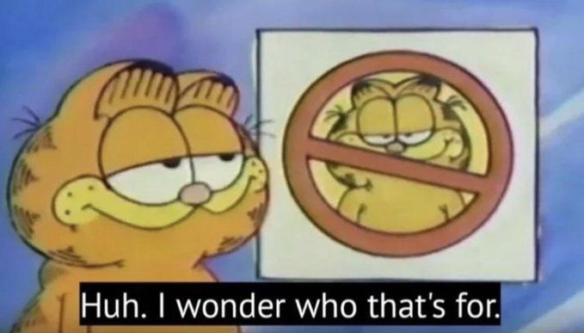
GETTING STARTED
A panel will open at the bottom of the program to give you your output
  You might hear me call this the output window, maybe the terminal, or just output, fyi
Red underlines are mistakes
Yellow underlines are called ‘warnings’
  Programmers do not listen to so called ‘warnings’ (you can generally ignore them)
If PyCharm asks whether you trust the project, say yes
→ SKILL CHECK 2
Notes:
First working line inside ten minutes or the room goes cold.

Slide 11
PRINT
print is a function - a named group of code that does a specific job
The parenthesis hold the argument, which is what you hand it to work on
The quoted part is a string, which is just text
That whole line is one statement, and Python runs them top to bottom, same as LMC did
print("Hello, world")

Slide 12
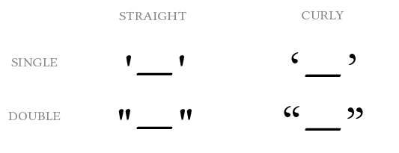
PRINT
Quotes come in pairs, as do parenthesis
  Miss one and the entire program will crash
Whatever you put inside the quotes comes back out exactly as typed, spaces included
Ensure your quotation marks are STRAIGHT not CURVY
  If you type a quotation mark in something like Word it will make it CURVY and that doesn’t work in a program
When Python can’t read a line, that’s a syntax error, stopping your code from running
→ SKILL CHECK 3
Notes:
Delete a closing bracket on the projector. Let them find it.

Slide 13

VARIABLES
A variable is a labelled box you put something into
  We don’t need quotation marks to access a created box
    If you used quotes, it would just print the text “name”, not the name stored in that variable
That = is an assignment
  Assignment stores a value, it does NOT mean ‘equal to’
name = "Michael"
print(name)
“Michael”
Name
Notes:
Say the = line twice. It is the sentence they forget.

Slide 14
VARIABLES
You can set whatever variable name you want, within reason
  Use letters, numbers and underscores
    No spaces, cannot begin with a number
  Use effective names: minutes tells us something, x does not
If you put a new value in the variable, it overwrites the old value, deleting it
→ SKILL CHECK 4
name = "Somebody else"
print(name)

Slide 15
INPUT
input function prints a string, maybe in this case a question, then stops and waits
  The program won’t continue until you type a value and hit enter into the terminal or output window
You must use the value, or store it into a variable, or what the user typed will be deleted
  Hence the name = before the print
name = input("What is your name? ")
Notes:
Run one without catching the answer, so they watch it vanish.

Slide 16
INPUT
A + between two strings is called concatenation, a long word for gluing strings together
Python won’t automatically put a space in, so put one inside your quotes
→ SKILL CHECK 5
print("Hello, " + name)

Slide 17
DATA TYPES
Back on Day 3 we said everything is a number underneath
Python has a few different ways of representing these numbers
  string - text, always inside quotes
  integer - a whole number, no decimal point
  float - a number with a decimal point
print(type(9)) # ask Python what it is actually holding

Slide 18
DATA TYPES
Try running these lines and tell me what result you’re given
input ALWAYS hands you back text, even when somebody types a number
A TypeError means Python is trying to work with a data type that it can’t use
→ SKILL CHECK 6
minutes = input("Minutes a week? ")
print(minutes + 5)
TypeError: can only concatenate str (not "int") to str
Notes:
Read the red out loud before you explain a word of it.

Slide 19
TYPE CASTING
Type casting turns a value of one type into another
  int() turns text into a whole number, IF and ONLY IF it is nothing but digits
  float() does the same job for decimals
str() goes the other way, so a number can join a sentence
→ SKILL CHECK 7
minutes = int(input("Minutes a week? "))
print("That is " + str(minutes) + " minutes")

Slide 20
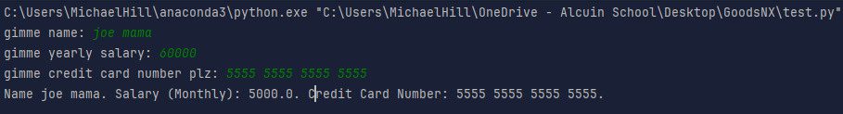
YOUR FIRST TOOL
Let’s build our first real tool
Ask for a name, for their salary, and their credit card number
Calculate the monthly salary, and print it alongside the name and the card number in a neatly formatted message.
The salary has to come in as a number
The monthly pay has to be converted back to a string to be printed

Slide 21
YOUR FIRST TOOL
If you’re stuck, here’s the shape of it
  round() cuts a long decimal down to one place
  12 months in year, obviously
→ SKILL CHECK 8
salary = int(input(“Salary? "))
monthly = round(salary / 12, 1)
print("Cost: " + str(hours) + " hours a year")
Notes:
Walk the room from here. Do not sit down.

Slide 22
BEFORE YOU LEAVE
Double check that each of your skill checks has your code, and the output pasted underneath it
  If you leave the output box empty I’ll assume it never ran!
If it broke, paste the red error message text
Ctrl+S saves
  Hit this constantly
Everything stays in myp_digital_design and we open it again next time
Upload your skill check file to ManageBac, named Surname_ICA2-1
→ SKILL CHECK 9

Slide 23
VOCAB TO REMEMBER
Statement - one instruction. Python runs them top to bottom
Function - a named thing that does a job for you, like print
Argument - what you hand a function, inside the brackets
String - text, always inside quotation marks
Variable - a labelled box with something in it
Assignment - the = that puts a value into the box
Input - the function that stops, asks, and hands back text

Slide 24
VOCAB TO REMEMBER
Concatenation - gluing strings together with +
Integer - a whole number, no decimal point
Float - a number with a decimal point
Type casting - turning a value of one type into another, like int()
Syntax error - Python can’t read your line, so nothing runs
TypeError - Python got a type it can’t work with there

